Slide 1


Construction Grammar: Merely a Set or a Connected Structure?
Evidence from the Russian Constructicon
Laura A. Janda
Valentina Zhukova
UiT The Arctic University of Norway
SCLC 2024
November 1­3–15, 2024

Slide 2
Plan for this talk
How constructions are organized in a language: inventorium VS. constructiCon
No construction is an island
Sets and elements subclass
Further types of interconnections across constructions

Slide 3
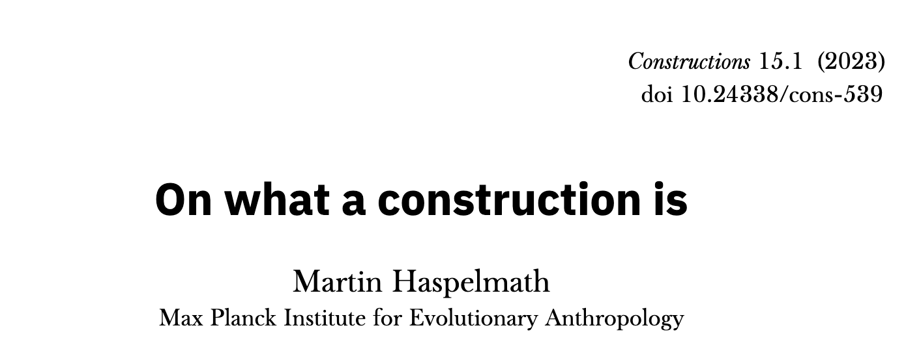
Point of departure

Slide 4


Interpretation
of Haspelmath
This leads to the question how we should call the set of conventional form-meaning pairs that comprises both lexemes and constructions. One could call it “extended lexicon” (treating constructions as kinds of lexical items) or “extended constructicon” (treating lexical items as kinds of constructions), but it seems better to give it a new name, such as inventorium (Haspelmath (2024),). This enables us to treat both lexemes and constructions as inventorial items, and we do not need to extend the meanings of older terms in a confusing way.
[Haspelmath 2023: 6]

Slide 5

Interpretation
of Haspelmath
Our claim
an interconnected system of thousands of constructions in which lexicon and grammar are fully integrated

Slide 6
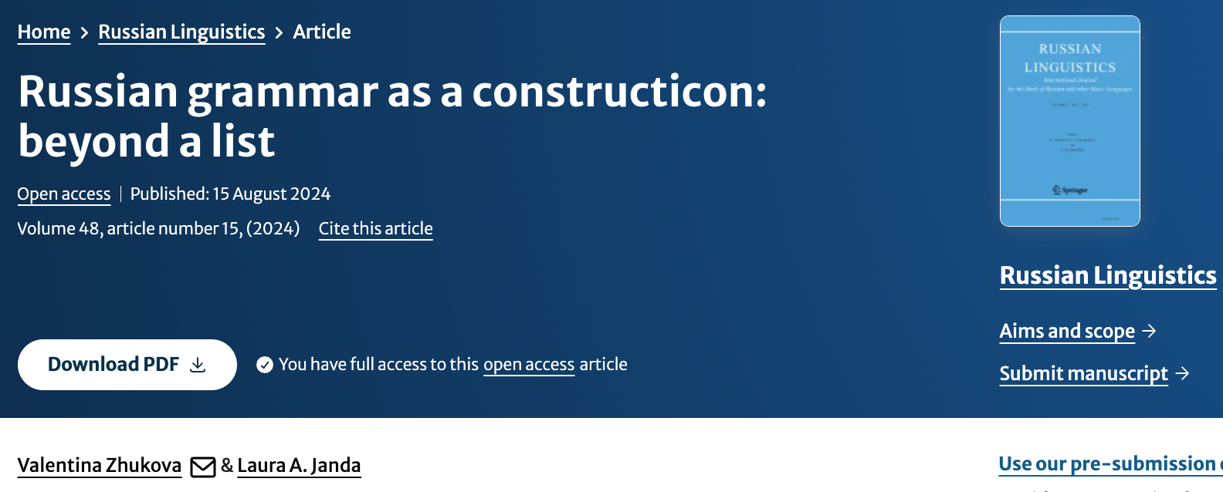
https://doi.org/10.1007/s11185-024-09298-z

Slide 7

No construction is an island

Slide 8

Any language can be described entirely in terms of constructions
Entire discourse structures
For example:
a debate
Complex
…___...
Morphemes / lexemes
See: dictionaries
Syntactic roles
See: core grammar
Concrete
(Anchor)
Abstract
(Slot)

Slide 9
All structures in a language belong to its constructicon
Entire discourse structures
For example:
a debate
Complex
…___...
Morphemes / lexemes
See: dictionaries
Syntactic roles
See: core grammar
Concrete
(Anchor)
Abstract
(Slot)

Slide 10
A constructicon is an intensely interconnected system, not a list
Entire discourse structures
For example:
a debate
Complex
…___...
Morphemes / lexemes
See: dictionaries
Syntactic roles
See: core grammar
Concrete
(Anchor)
Abstract
(Slot)

Slide 11
“Edges” of constructicon are traditionally described
Entire discourse structures
For example:
a debate
Complex
…___...
Morphemes / lexemes
See: dictionaries
Syntactic roles
See: core grammar
Concrete
(Anchor)
Abstract
(Slot)

Slide 12
Entire discourse structures
For example:
a debate
Complex
Constructions consisting of multiple anchors and/or slots
…___...
Morphemes / lexemes
See: dictionaries
Syntactic roles
See: core grammar
Concrete
(Anchor)
Abstract
(Slot)

Slide 13
Entire discourse structures
For example:
a debate
Complex
Constructions related to each other by similarities of meaning and form
…___...
Morphemes / lexemes
See: dictionaries
Syntactic roles
See: core grammar
Concrete
(Anchor)
Abstract
(Slot)

Slide 14

Our Construction Grammar “whole-language” approach
Previous studies of reduplication in Russian target a single construction or group of constructions
Our study is based on the Russian Constructicon (RusCon), a representation of the Russian language as a system of constructions (2277 cxns)
6% (135 cxns) of constructions in RusCon involve reduplication
“Whole-language” approach reveals patterns that connect reduplication to the broader repertoire of Russian constructions
The variety of reduplication types in Russian mirrors types found in languages with grammatical reduplication
Notes:
We analyze Russian reduplicative constructions from the perspective of Construction Grammar, with particular emphasis on how the entire system of constructions is structured in Russian, and with the benefits of terminological conventions that have been developed for the Russian Constructicon
While there is vast and constantly growing body of literature devoted to case studies of individual Russian reduplicative constructions, (their uses and sub-uses, and their families), reduplication in Russian has not been much studied systematically from a broader perspective. We conducted a study based on the Russian Constructicon which is supposed to represent the Russian language as a system of constructions. Our study revealed that 135 cxns from our database involve reduplication of various kinds.
Interestingly, reduplicatve constructions in Russian mirror the types that are found in languages with grammatical reduplication.
This whole language approach is beneficial as it reveals patterns that connect reduplication to the overall system of Russian constructions.

Slide 15
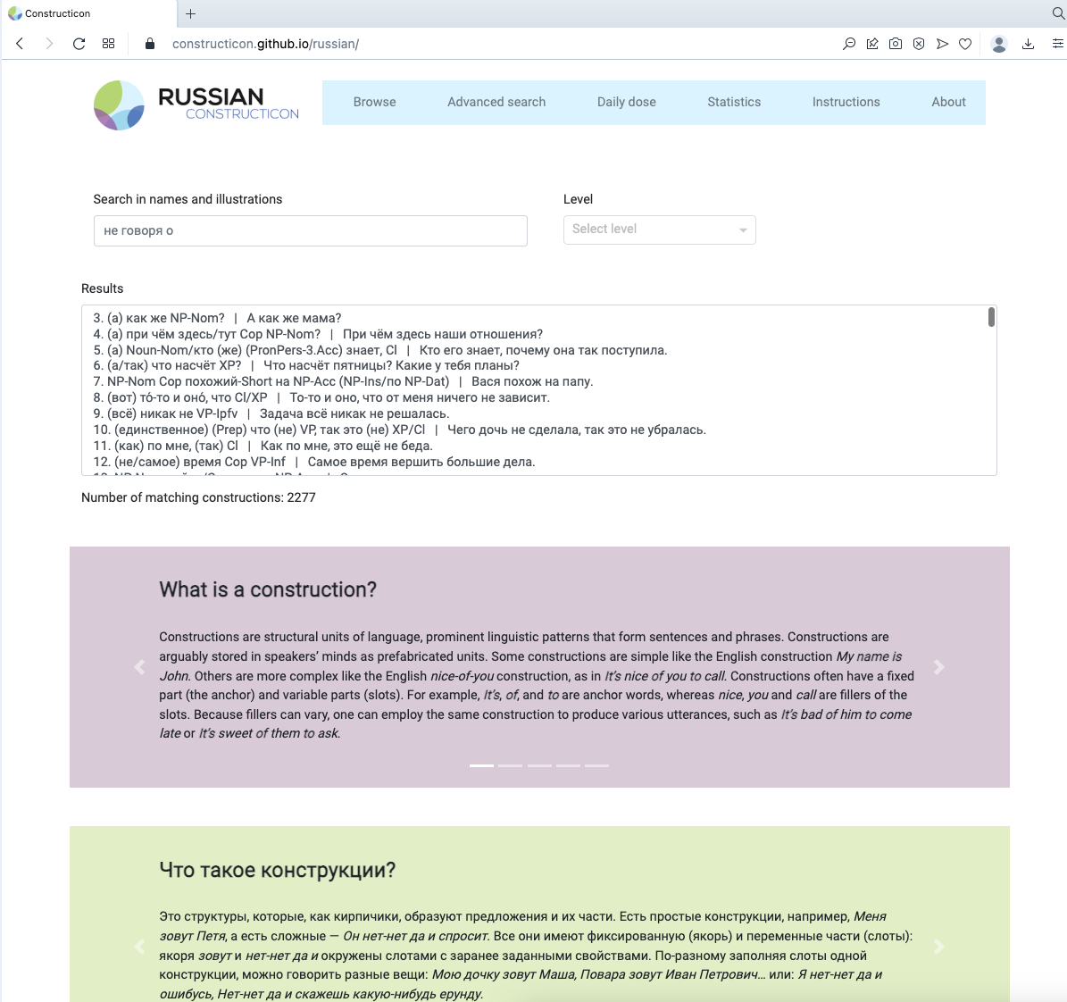
The Russian Constructicon
A searchable database of over 2200 Russian constructions
Open access
Available at https://constructicon.github.io/russian/
Notes:
While it is probably impossible to compile an entirely comprehensive database of the constructions of a given language, our aim has been to gather enough constructions to realistically represent the repertoire of the Russian language as a whole. This project underwent continuous revision until a stable pattern of semantic and syntactic types emerged such that the addition of further constructions became a matter of filling out existing types rather than identifying new ones. The conventions devised and systems observed in this project thus relate to the Russian language in its entirety, giving us a macroscopic view on the place of reduplicative constructions in the language.

Slide 16
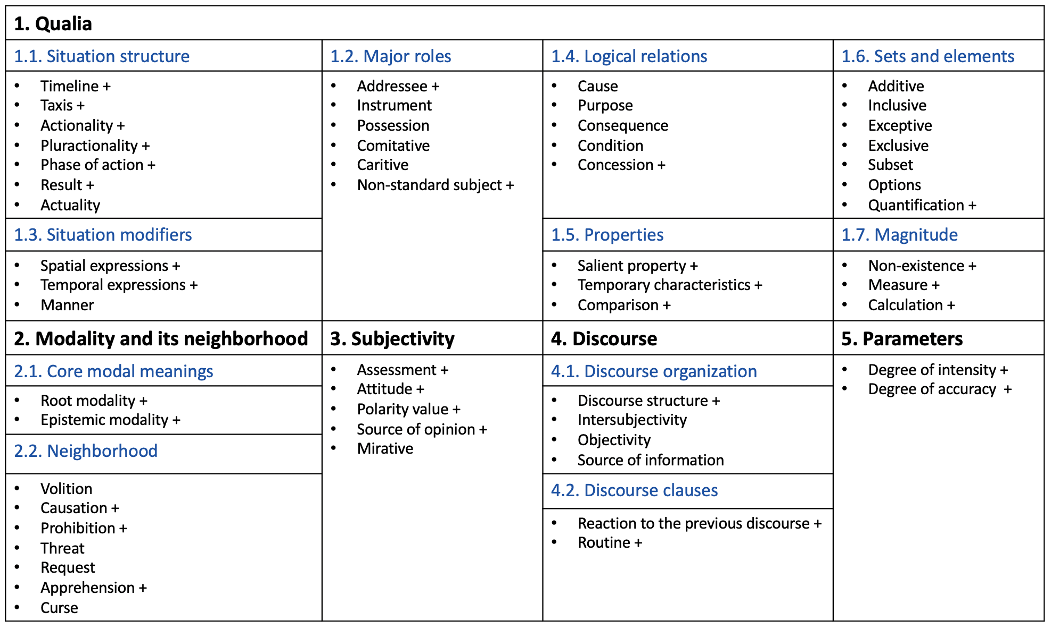
Semantic classification of RusCon
The constructions of this subclass contain information on the relationship between an element and a set
All constructions are classified in 55 semantic types that contain 182 subtypes
Janda, L. A., A. Endresen, V. Zhukova, D. Mordashova, E. Rakhilina. 2023. From data to theory: an emergent semantic classification based on the large-scale Russian constructicon. Constructions and Frames 15(1), 1-58.
Notes:
In the system of semantic classification
Available online
Most Discourse “Echo” constructions express Agreement, Disagreement, or Surprise, though there is some variation here too.

Slide 17
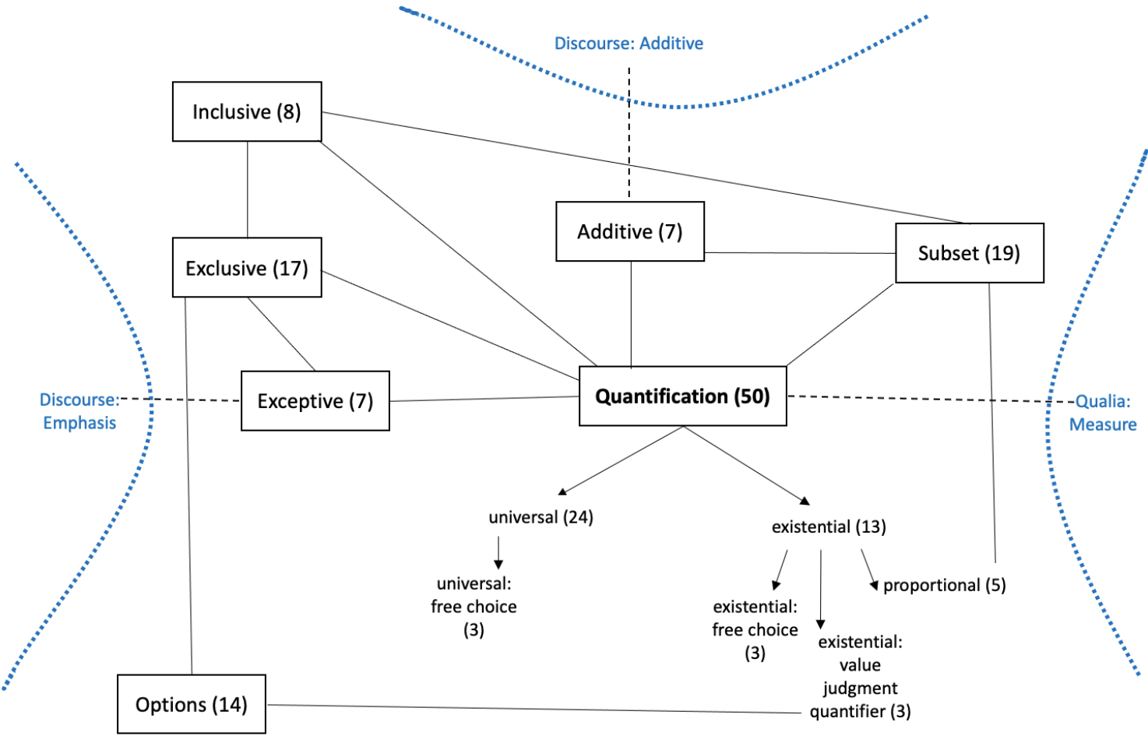
Sets and elements subclass
superordinate class
Qualia
subclass
Sets and elements
semantic type
Quantification
semantic subtype
Universal
ID 433 (NP) все до единый-Gen Cl
Они все до единого присутствовали на собрании.
‘Every single one of them was present at the meeting.’
110 constructions across seven semantic types

Slide 18
Constructions with multiple semantic affinities
superordinate class
Qualia
subclass
Sets and elements
Major roles
semantic connections to constructions across semantic types and subclasses
semantic type
Exceptive
Caritive
ID 1905 за исключением NP-Gen, Cl – Я прочитал всё, за исключением последней главы.
‘I read everything except for the last chapter.’
17

Slide 19
Sets and elements subclass

Slide 20
Semantic affinity at a higher level
expresses the addition of information to an ongoing discourse
Additive
(1) ID 800 VP в придачу (к NP-Dat) - В придачу к медали он получил премию.
‘In addition to the medal, he received a cash prize.’
Discourse Additive
(2) ID 1092 к слову (сказать), Cl - К слову, он тоже окончил этот факультет.
‘By the way, he also graduated from this department.’
expresses the addition of elements to a set
Notes:
Individual constructions may belong to various groups both within and across semantic classes and types. There are furthermore entire semantic types that are related across the semantic classes. An example of such an affinity at a higher level is between the Discourse additive type in the Discourse semantic class and the Additive type within Qualia.

Slide 21
Syntactic affinities: 4 aspects
SYNTACTIC TYPE OF CONSTRUCTION
Matrix and Sentential Complement Construction
SYNTACTIC FUNCTION OF ANCHOR
Matrix Predicate
Subordinator
ID 336 только и NP-Gen.Pl Cop, что Cl
Только и разговоров, что о доме.
‘All they ever talk about is their house.’
SYNTACTIC STRUCTURE OF ANCHOR
Multiword Conjunction
PART OF SPEECH OF ANCHOR
Particle
Conjunction

Slide 22
Further types of interconnections across constructions
Notes:
Based on the data that is gathered in the Russian Constructicon, reduplication is better understood broadly. It involves repetition of an element that is attested both within and across the clause boundary. The latter type is called discourse echo type of constructions. These cxns have non-prototypical semantic and structural properties. The most important one is that these constructions are literally born in the moment of verbal interaction between two speakers.
this is indeed the first large-scale study of reduplicative constructions in Russian, and its contribution is both empirical and theoretical.
The general theoretical contribution would be: even if a language rarely uses reduplication in morphology, this language can still feature a variety of reduplication patterns in multi-word constructions.
This phenomenon raises important questions to construction grammar
Where do the boundaries of cxns lie?
What criteria can help to establish these boundaries?
Can speakers in a conversation co-create a single cxn?

Slide 23
We focused on semantic and syntactic links
Other possible interconnections
Morphology: e.g., cxs with Dative or Imperative
Semantic role of slot: e.g., cxs with Agent or Goal
Anchor lexeme: e.g., cxs with время
Filler lexeme: e.g., cxs with деньги
Usage / communicative type: e.g., cxs tagged as Colloquial, Exclamatory
Intonation
Gesture
Currently facilitated by filters in Russian Constructicon

Slide 24
Take-home message
Construction Grammar facilitates a view of the Russian language as a coherent whole in which lexicon and grammar are fully integrated. The unit of interest is the construction, ranging from atomic units to complex discourse structures. Between these extremes lies an interconnected system of thousands of multiword constructions. These multiword constructions are the primary focus of Construction Grammar and of the Russian Constructicon.

Slide 25
Thank you!

Slide 26
References
Freywald, Ulrike and Rita Finkbeiner. 2018. Exact repetition or total reduplication? Exploring their boundaries in discourse and grammar. In Rita Finkbeiner and Ulrike Freywald (eds.), Exact Repetition in Grammar and Discourse, 3–28. De Gruyter Mouton.
Helasvuo, Marja-Liisa. 2001. Syntax in the Making: The emergence of syntactic units in Finnish conversation. John Benjamins.
Hopper, Paul J. 1988. Emergent Grammar and the A Priori Grammar Postulate. In Deborah Tannen (ed.), Linguistics in Context, 117–134. Ablex.
Lyngfelt, Benjamin, Linnéa Bäckström, Lars Borin, Anna Ehrlemark & Rudolf Rydstedt. 2018. Chapter 3. Constructicography at work: Theory meets practice in the Swedish constructicon. In Lyngfelt, B., Borin, L., Ohara, K., & Torrent, T. T. Constructicography (Vol. 22). John Benjamins Publishing Company. https://doi.org/10.1075/cal.22.03lyn
Mesch, Johanna, Eli Raanes, and Lindsay Ferrara. 2015. Co-forming real space blends in tactile signed language dialogues. Cognitive Linguistics 26(2), 261–287. DOI 10.1515/cog-2014-0066
Moravcsik, Edith. 1978. Reduplicative constructions. In: Joseph H. Greenberg (Ed.), Universals of human language, vol. 3, 297–334. Stanford University Press.
Schegloff, Emanuel. 1991. Conversation Analysis and Socially Shared Cognition. In Lauren Resnick, John Levine and Stephanie Teasley (Eds.), Perspectives on Socially Shared Cognition, 150–171. American Psychological Association.
Ono, Tsuyoshi & Sandra A. Thompson. 1995. What can Conversation tell us about Syntax? In Philip Davis (ed.), Alternative Linguistics: Descriptive and Theoretical Modes. Current Issues in Linguistic Theory, vol. 102, 213–271. John Benjamins.

Slide 27
Extra slides

